Slide 1

Ansible for Beginners
Presented By:
Mohammed Moin

Slide 2
Agenda
What is Ansible?
Why Automation ?
Why use Ansible?
Ansible Architecture
Ansible Installation
Key Concepts
Ansible ad hoc commands
Ansible Modules
YAML & Playbooks
Demo: Writing and Running Playbooks
Demo: Configuration Management using Ansible
Demo: Using Custom Inventory
Demo: Working With Multiple Playbooks

Slide 3
What is Ansible
Ansible is a radically simple IT automation platform that makes your applications and systems easier to deploy.
Developed by Red Hat.
Used for:
Configuration Management
Application deployment
Continuous testing of already install application
Provisioning
Orchestration
Automation of tasks

Slide 4
Why Automation?
Tasks in code
Collaboration
Eliminate errors
Write once
Laziness
Etc….

Slide 5
Why Ansible
Agentless – No need for agent installation and management
Simple to learn (uses YAML syntax).
Idempotent – ensures same result every time it runs.
Flexible and Scalable.
Huge community and rich module ecosystem (In built and Custom modules.)
Configuration roll-back in case of error
Simple and human readable

Slide 6
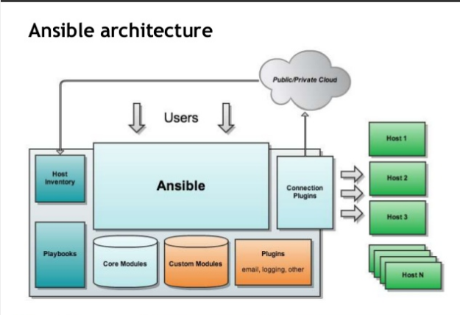
Ansible Architecture

Slide 7
Installation of Ansible
apt-get update –y
apt-add-repository ppa:ansible/ansible
apt-get update –y
apt install ansible –y
add-apt-repository --yes --update ppa:ansible/ansible
ansible –version

Slide 8
Installation of Ansible
vim /etc/default/locale
Append the below and restart vm
LC_CTYPE=en_US.UTF-8

Slide 9
Key concepts
Inventory – defines your infrastructure. A collection of all the hosts and groups that Ansible manages.
Playbook – written in YAML, defines tasks to perform.
Tasks – actions like installing packages, starting services.
Modules – units of work (e.g., apt, service, copy).
Variables – customize configuration.
Roles – reusable, structured playbooks.
Host: A remote machine managed by Ansible.
Group: Several hosts grouped together that share a common attribute.
YAML: A popular and simple data format that is very clean and understandable by humans.

Slide 10
Create the RSA Key Pair for Passwordless login
The first step is to create the key pair on the Server machine
ssh-keygen –t rsa
Once you have entered the Gen Key command, you will get a few more questions:
Enter file in which to save the key (/home/test/.ssh/id_rsa):
Enter no password for the next prompt
Copy the Public Key using cat /root/.ssh/id_rsa.pub
Login to the console of the host machines. Then, paste and save the copied RSA public key in the authorized_keys file in the /root/.ssh/ path.
Repeat the same process for other machines you wish to login automatically with.

Slide 11
Alternate Way..
ssh-copy-id test@192.168.85.135
Repeat the same process for other machines you wish to login automatically with.
Ensure the test username has sudo access to the remote clients

Slide 12
Configuration of Ansible
Do the following on the Server machine
Create the list of client machines you wish to access via this server
vi /etc/ansible/hosts ( And enter the following lines and save file)
[Servers]
192.168.85.135
192.168.85.136

Slide 13
Configuration of Ansible
Use the following command to see the servers that have been added to your inventory file.
ansible-inventory --list -y
Run the ping command below to see if indeed you are reaching both client nodes
ansible -m ping all

Slide 14
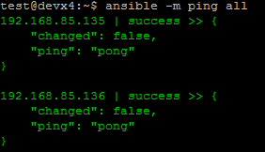
Examples of Ansible commands
The output show ping result success as shown below

Slide 15
Ansible ad-hoc commands
Using ad hoc commands is a quick way to run a single task on one or more managed nodes.
Some examples of valid use cases are rebooting servers, copying files, checking connection status, managing packages, gathering facts, etc.
The pattern for ad hoc commands looks like this:
$ ansible [host-pattern] -m [module] -a “[module options]”
host-pattern: the managed hosts to run against
-m: the module to run
-a: the list of arguments required by the module

Slide 16
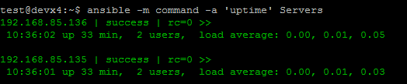
Examples of Ansible commands (Cont..)
How to run commands to fetch hard drives utilization
ansible -m command -a 'df -h’ all
ansible all -m command -a "/bin/echo hello"
How to run commands to fetch system uptime
ansible -m command -a ‘uptime' Servers

Slide 17
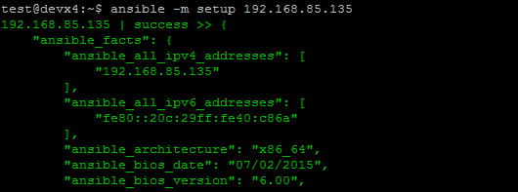
Examples of ansible commands ( Cnt)
The full configuration environment inventory of a particular client machine can be obtain using the command below.
ansible -m setup 192.168.85.135 ( output as shown below)

Slide 18
Ansible Modules
Ansible modules are reusable, standalone scripts or programs
Perform specific tasks on managed hosts or via APIs,
Such as managing configurations, deploying applications, or orchestrating systems.
They serve as the building blocks for automation, allowing users to execute predefined actions on remote systems.

Slide 19
YAML & Playbooks
Playbooks are the files where Ansible code is written. Playbooks are written in YAML format.
Playbooks are one of the core features of Ansible and tell Ansible what to execute. They are like a to-do list for Ansible that contains a list of tasks.
Playbooks contain the steps which the user wants to execute on a particular machine.
Playbooks are run sequentially.
Playbooks are the building blocks for all the use cases of Ansible.

Slide 20
Playbook Structure
Each playbook is an aggregation of one or more plays in it.
Playbooks are structured using Plays. There can be more than one play inside a playbook.
The function of a play is to map a set of instructions defined against a particular host.
YAML is a strict typed language; so, extra care needs to be taken while writing the YAML files. A YAML starts with --- (3 hyphens)

Slide 21
Playbook Example
---
name: install and configure DB
hosts: server/list
become: yes
tasks:
-name: Install the Mysql DB
yum: <code to install the DB>
-name: Ensure the installed service is enabled and running
service:
name: <your service name>

Slide 22
Creating an ansible-playbook

Slide 23
Configuration Management using Ansible
Configuration management ensures systems (like servers or containers) are in a desired, consistent state by automating:
Installing software
Managing files
Ensuring services are running
Setting users and permissions
With Ansible, configuration management is:
Agentless (uses SSH)
Idempotent (safe to run multiple times)
Human-readable (YAML syntax)

Slide 24
Configuration Management using Ansible Demo

Slide 25
Ansible Documentations
You can find more explanation in the Ansible Docs.
Ad-hoc commands
Inventories
Variables
Modules
Playbook Roles
Similar tools that does the same function as Ansible are as below.
Puppet
Chef
Salt

